Slide 1
HTML

Slide 2
New HTML5 Elements
The most interesting new HTML5 elements are:
New semantic elements like <header>, <footer>, <article>, and <section>.
New attributes of form elements like number, date, time, calendar, and range.
New graphic elements: <svg> and <canvas>.
New multimedia elements: <audio> and <video>.

Slide 3
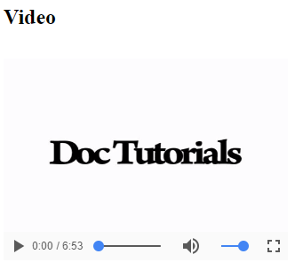
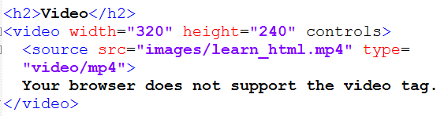
The HTML <video> Element
To show a video in HTML, use the <video> element.
Notes:
The controls attribute adds video controls, like play, pause, and volume.
It is a good idea to always include width and height attributes.
Text between the <video> and </video> tags will only display in browsers that do not support the <video> element.
Multiple <source> elements can link to different video files. The browser will use the first recognized format.

Slide 4
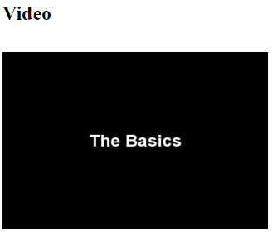
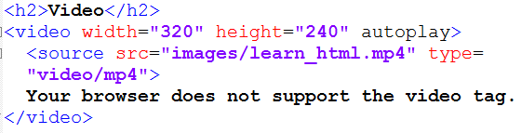
HTML <video> Autoplay
To start a video automatically use the autoplay attribute.

Slide 5
Playing a YouTube Video in HTML
To play your video on a web page, you can upload it to YouTube, and then insert the proper HTML code in your web page to display it using iframe.
YouTube will display the code to use (like:XGSy3_Czz8k), when you click "Share" under the video.

Slide 6
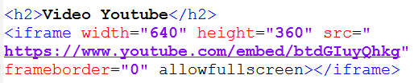
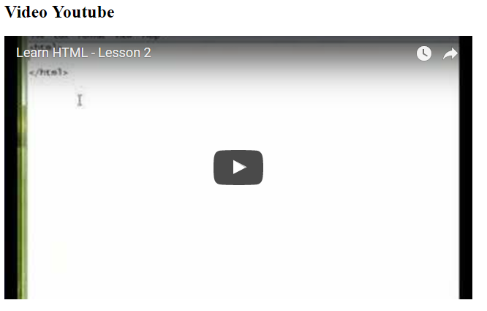
Playing a YouTube Video in HTML (2)

Slide 7
The HTML <audio> Element
To play an audio file in HTML, use the <audio> element:
<audio controls> <source src="horse.ogg" type="audio/ogg"> <source src="horse.mp3" type="audio/mpeg"> Your browser does not support the audio element. </audio>

Slide 8
HTML Helper (Plug-ins)
Helper applications are also called plug-ins.
Examples of well-known plug-ins are Java applets.
Plug-ins can be added to web pages with the <object> tag or the <embed> tag.
Plug-ins can be used for many purposes: display maps, scan for viruses, verify your bank id, etc.

Slide 9
The <object> Element
The <object> element is supported by all browsers.
The <object> element defines an embedded object within an HTML document.
It is used to embed plug-ins (like Java applets, PDF readers, Flash Players) in web pages.

Slide 10


The <object> Element (cont.)

Slide 11
The <embed> Element
The <embed> element is supported in all major browsers.
The <embed> element also defines an embedded object within an HTML document.

Slide 12

The <embed> Element (cont.)

Slide 13
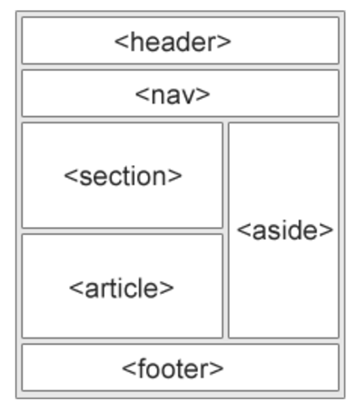
HTML Semantic Elements
Many web sites contain HTML code like: <div id="nav"> <div class="header"> <div id="footer"> to indicate navigation, header, and footer.
HTML5 offers new semantic elements to define different parts of a web page:
Notes:
"A section is a thematic grouping of content, typically with a heading."
The <article> element specifies independent, self-contained content, example: forum post, blog post, newspaper article.
The <header> element specifies a header for a document or section.
The <footer> element specifies a footer for a document or section.
The <nav> element defines a set of navigation links. It is intended only for major block of navigation links.
The <aside> element defines some content aside from the content it is placed in (like a sidebar).

Slide 14
HTML Head
The <head> element is a container for metadata (data about data) and is placed between the <html> tag and the <body> tag.
HTML metadata is data about the HTML document. Metadata is not displayed.
Metadata typically define the document title, character set, styles, links, scripts, and other meta information.
The following tags describe metadata: <title>, <style>, <meta>, <link>, <script>, and <base>.

Slide 15
HTML Head (cont.)
The <title> element defines the title of the document, and is required in all HTML/XHTML documents.
The <title> element:
defines a title in the browser tab
provides a title for the page when it is added to favorites
displays a title for the page in search engine results

Slide 16
HTML Head (cont.)
The <style> element is used to define style information for a single HTML page.
<style> body {background-color: powderblue;} h1 {color: red;} p {color: blue;} </style>

Slide 17
HTML Head (cont.)
The <link> element is used to link to external style sheets.
<link rel="stylesheet" href="mystyle.css">

Slide 18
HTML Head (cont.)
The <meta> element is used to specify which character set is used, page description, keywords, author, and other metadata.
Metadata is used by browsers (how to display content), by search engines (keywords), and other web services.
<meta charset="UTF-8"> <meta name="description" content="Free Web tutorials"> <meta name="keywords" content="HTML,CSS,XML,JavaScript"> <meta name="author" content="John Doe">

Slide 19
HTML Head (cont.)
The viewport is the user's visible area of a web page. It varies with the device, and will be smaller on a mobile phone than on a computer screen.
You should include the following <meta> viewport element in all your web pages.
A <meta> viewport element gives the browser instructions on how to control the page's dimensions and scaling.
<meta name="viewport" content="width=device-width, initial-scale=1.0">

Slide 20
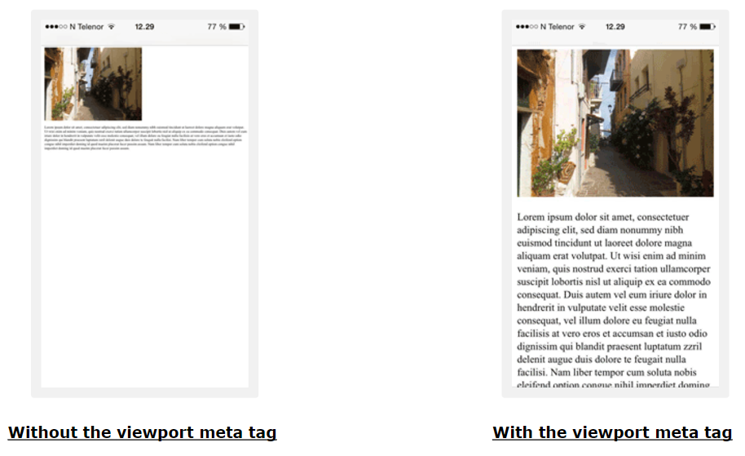

Slide 21
HTML Head (cont.)
The <script> element is used to define client-side JavaScripts.
<script> function myFunction { document.getElementById("demo").innerHTML = "Hello JavaScript!"; } </script>

Slide 22
HTML Head (cont.)
The <base> element specifies the base URL and base target for all relative URLs in a page.
<base href="https://www.w3schools.com/images/" target="_blank">

Slide 23
New HTML5 API's (Application Programming Interfaces)
The most interesting new API's in HTML5 are:
HTML Geolocation
HTML Drag and Drop
HTML Local Storage
HTML Application Cache
HTML Web Workers
HTML SSE

